Slide 1
UXADMIN - Widgets

Slide 2
Requirement to access Widgets
Staff user must have Library or Customer Superuser permission in order to access UXADMIN. UXADMIN is the area where widgets are administered.

Slide 3
What are Widgets
A software widget is a relatively simple and easy-to-use software application
In UxAdmin Widgets, chosen user content is stored for future recall and display in our application.
Widget Manager - Lets you create and maintain “widgets” (informational or pictorial elements) that can be selectively added to informational pages.

Slide 4
Widget Types

Slide 5
Creating Widgets
Getting started - Review Staff Documentation Resources
Users Guides: UX Administration
Training Videos: Note, new video effect March 2017

Slide 6
Cont… Creating Widgets
Creating a…
FEEDBACK widget
Topic Search widget
Showcase widget
Content widget
NOTE: You can create as many widgets as you like and no widget is visible to any users until you decide to put them onto a page.

Slide 7
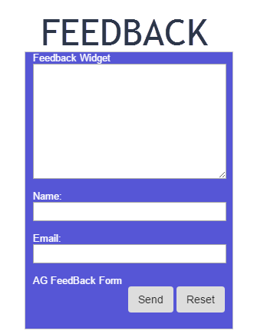
Cont… Creating Widgets
FEEDBACK widget

Slide 8
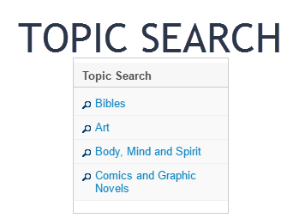
Cont… Creating Widgets
Creating a…
Topic Search widget

Slide 9
Cont… Creating Widgets
Creating a…
Showcase widget
Standard / One-Up
List / Dynamic

Slide 10
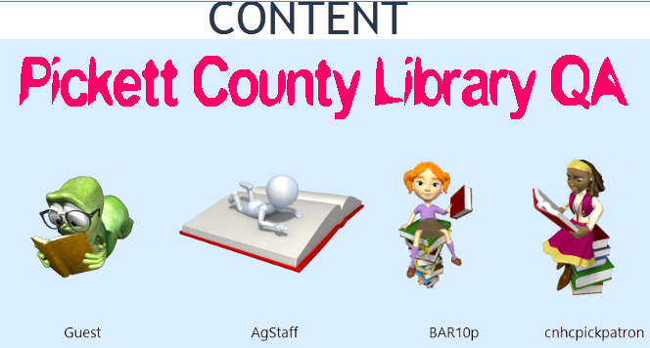
Cont… Creating Widgets
Creating a…
Content widget
See Advance training video (Documentation / Training Videos)
Elements
Text
Weblinks
Pictures
Via Weblink
Via Uploading
Iframes
Websites (Https websites are enforced)
Videos
Youtube (Embedded Url Structure) “https://www.youtube.com/embed/YOUTUBEID”
Optional Video Parameters (“autoplay” and “rel”)
Autoplay=1 will autoplay the video, rel=0 will prevent the related videos appearing after video.
Suggested url parameter string to use “?autoplay=0&rel=0”
Other Parameters: https://developers.google.com/youtube/player_parameters
NOTE: A content widget can contain several forms of data simultaneously. (Text, Weblinks, Pictures and Iframes). The content widget is then saved and later added to a Page.

Slide 11
UXADMIN Page Manager (Make those Widgets Visible)
Page Manager
Allows pages to be created (Using Widgets) you had created prior.
Link Page
Allows a specific Website to be opened in a popup window.
Widget Page
Allows you to drop multiple widgets on a canvas which creates a page that is displayed in the interface.
NOTE: A widget page can contain several different widgets at once.

Slide 12
Question / Answer

