Slide 1
Verso – Version 6
What’s new and what’s changed in UX ADMIN
In depth handout for customer reference
Created by:
Tony Ricci
Customer Service Manager

Slide 2
Introduction
UX Admin is used by staff to configure the User Interface (UI) settings on behalf of the library.
At a high level, these configuration choices govern the OPAC’s look and behavior.
As such, UX Admin changes will affect everyone using the library – guests, patrons, and staff.

Slide 3
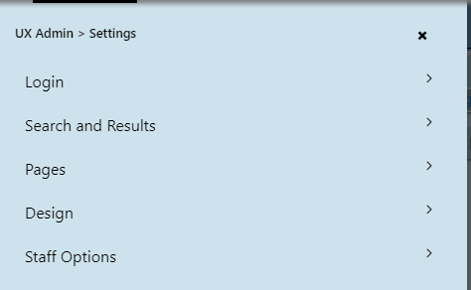
UX ADMIN Settings sections
In version 5, UX ADMIN was set up to include several links
In version 6, all of the links are now linked together under UX ADMIN SETTINGS
Some of the sections have new titles (example: header, footer, and color theme are listed under DESIGN
The image provided is an overview of the UX Settings menu

Slide 4
Design: Themes and Styles
Feature | Version 6 | Version 5
Themes and Styles
New Theme | The library can define its own color scheme from a palette of existing schemes or can design its own from scratch. | Same
Use Existing Theme | Enables the library select from a set of system-preconfigured color schemes or from schemes the library has previously defined. | Same
Footer Options | Enables the library to define its own footer data, using the Pages functionality. | Same, although Version 6 has additional capabilities.

Slide 5
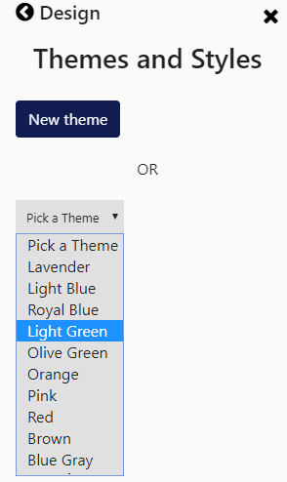
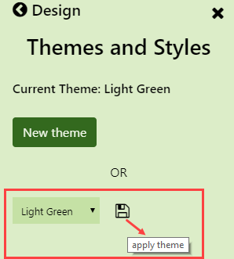
Design: Themes and Styles
Use Existing Theme:

Slide 6
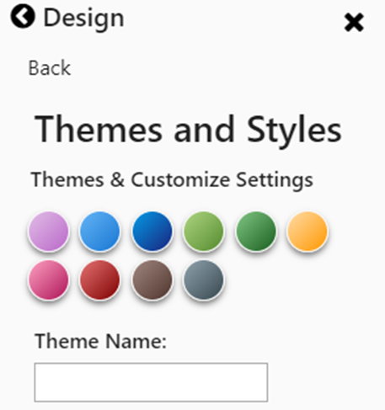
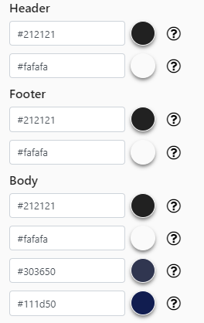
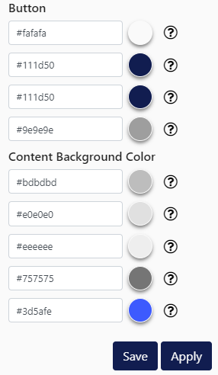
Design: Themes and Styles
New Theme:

Slide 7
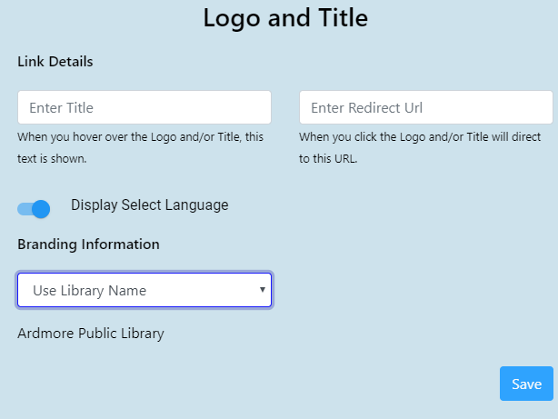
Design: Theme and Style
Header Options:

Slide 8
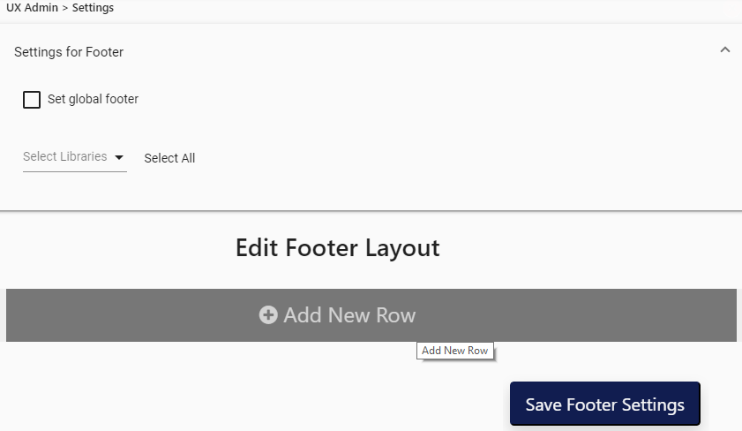
Design: Themes and Styles
Footer Options:

Slide 9
Pages
Library splash pages and widgets are now built in a single template-based interface, called “PAGES”, making design and setup far simpler.
Each page component has additional options for color, size, etc.
Several new components, including a “most requested title” component based on most-requested holds
The ability to schedule a page to go ‘live’ on a particular date.
The ability to toggle a page to go ‘live’ or go inactive.

Slide 10
Pages
What is a template?
A template is a pre-designed page with various arrangements that can be changed as needed.
In V6, libraries select the template to use, and then select the types of components that will be contained in each of the placeholders – they are integrated for easy design.
In Version 5, libraries had to drag and drop their widgets and try to make them fit.

Slide 11
Pages
What is a component?
A component is similar to a what used to be known as a Version 5 widget. A component has a specific display or informational function, and fits into a location on the template.
In Version 5, widgets were managed separately from pages.
In Version 6, components are managed within templates.

Slide 12
Create a New Page
Feature | Version 6 | Version 5
Create a New Page | Enables staff to create a new splash page to display on the library’s pages. This is designed using the tools below. In Version 6, components (widgets) are created on the page itself. | Page creation and widget creation were distinct functions in different area. At the end of the widget creation process, staff would insert widgets onto a page.
Title | The library assigns a page title to the work in progress | Same
Template | Eighteen templates (layouts) for pages are available (see left). Staff chooses the layout desired. | Version 5 did not use templates. Staff would create widgets and then drag and drop them across a page.

Slide 13
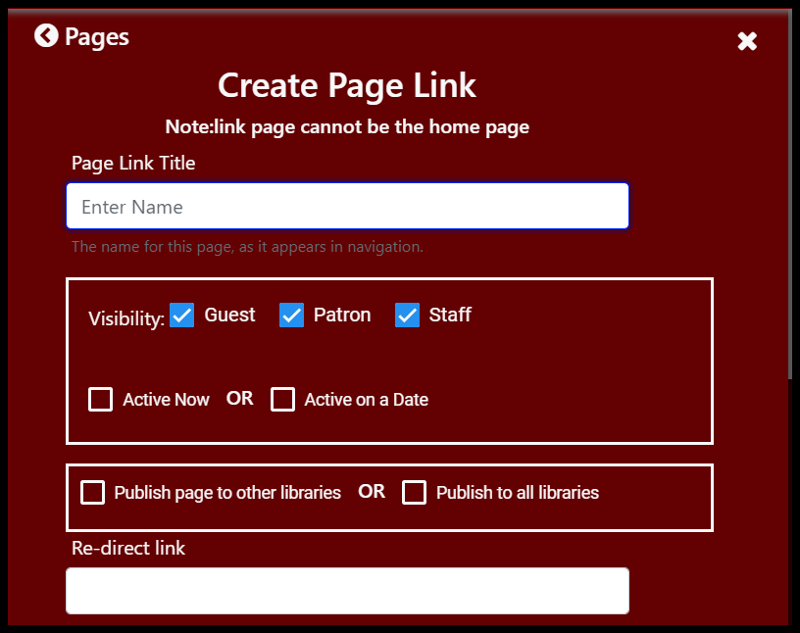
Create Page Link
Feature | Version 6 | Version 5
Create Page Link | A special type of page is one that links directly to a remote website from the Splash page. This configuration enables staff to give the remote web link a title and supply the remote URL for an automatic redirect. Staff can schedule Page Link pages to become active at a future date. | Same, except that pages were immediately visible and could not be scheduled.

Slide 14
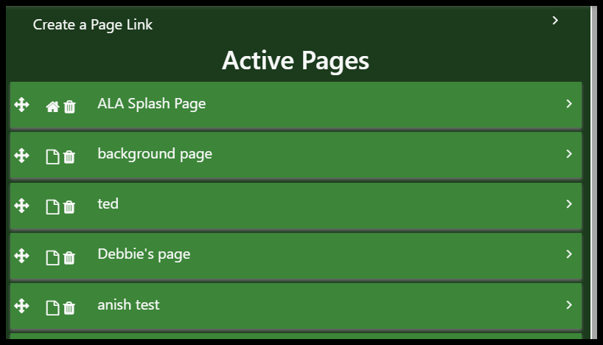
Active and Inactive Pages
Feature | Version 6 | Version 5
Active and Inactive Pages | The upper portion of the display lists pages that are actively used and displayed to the public. The lower section of the display lists inactive pages, which may include older pages, or pages that are in the process of being built. | Indicated in a different way.

Slide 15
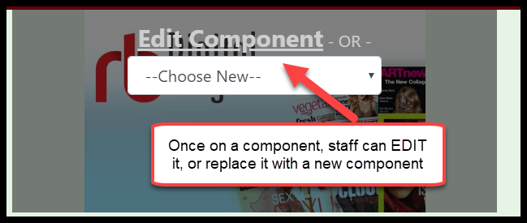
Editing Pages
Once on a page, staff can build components (widgets) from within that page. The following several pages describe nine available component types:
Call to Action
Image Block
Popular Carousel
List Carousel
Showcase Carousel
Feedback
Text Block
Topic Search
Embedded Web Links

Slide 16
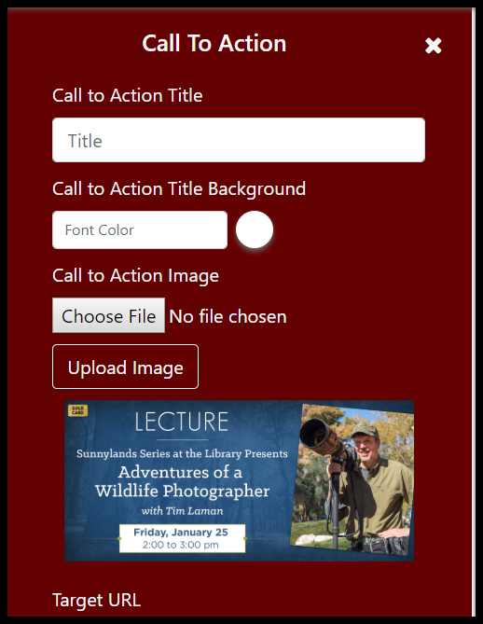
Adding/Editing Pages
Component Type (1 of 9): Call to Action
This is an example of a component setup / edit screen.
Setup configurations will change, depending on the type of component, as described below.
This component allows assignment of a title, decisions of background and foreground colors, and enables uploading of an image.
Component | Version 6 | Version 5
Call to Action | Call to Action is most similar to the Version 5 Content Widget. Staff can enter a title, add an image, adjust background and foreground colors, select button text, fonts and colors, etc. The library can also assign a remote URL to the button, enabling a user to link out from that Call to Action component. | Similar to Version 6 Call to Action widget (see left) but far fewer functions and configurations.

Slide 17
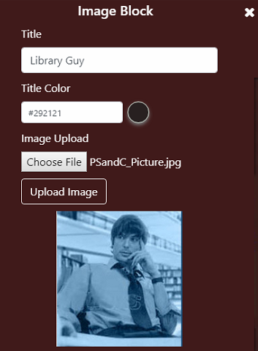
Adding/Editing Pages
Component Type (2 of 9): Image Block
Component | Version 6 | Version 5
Image Block | An Image Block component simply displays an uploaded image (photo, art, etc.) Staff can provide a title / header for the image and assign title foreground and background colors. | Was built into Content Widget. No background, color, or label options.

Slide 18
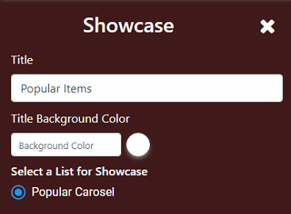
Adding/Editing Pages
Component Type (3 of 9): Popular Carousel
Component | Version 6 | Version 5
Popular Carousel | The Popular Carousel / Showcase is derived from Holds / Reserves transaction activity and displays cover art and links to items that are considered “Popular”. For VERSO, Data and titles in the carousel are recalculated once a day (at midnight) and considers the previous fourteen days of new holds activity. “Popular” means “most requested” and is calculated based on the total number of active, unfilled holds across that customer. For SHAREit, Title, ISBN, Publisher and PubDate are grouped and counts of each title are used to display popular title on the display. | Not offered

Slide 19
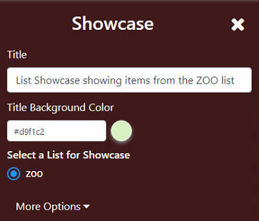
Adding/Editing Pages
Component Type (4 of 9): List Carousel
Component | Version 6 | Version 5
List Carousel | A List Carousel is a showcase display that is based on a Personal list that was compiled by staff. Staff would use the standard “Add to List” options in the OPAC to assemble a set of titles. Then, in the List Carousel component, staff would designate that list as the basis for a List Carousel. | Supported in Version 5, but list assembly took place within the widget and it was much more difficult and time consuming to assemble a carousel.

Slide 20
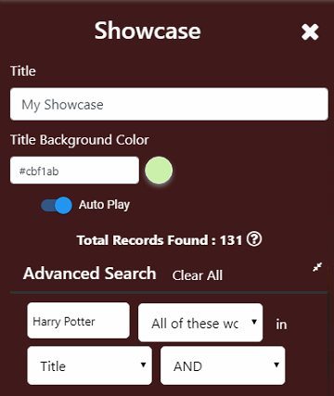
Adding/Editing Pages
Component Type (5 of 9): Showcase Carousel
Component | Version 6 | Version 5
Showcase Carousel | A showcase carousel is similar to a Dynamic showcase in Version 5. Staff enters a search; that search is executed at the time of display and displays the cover art that responds to the search. The search interface in the Showcase Carousel is similar to the Advanced Search interface in the OPAC. | Same

Slide 21
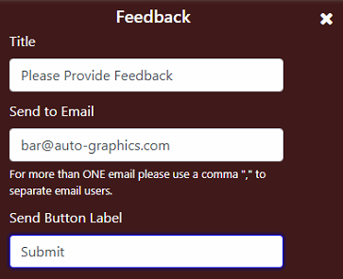
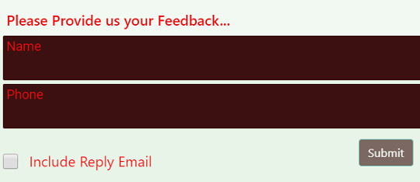
Adding/Editing Pages
Component Type (6 of 9): Feedback
Component | Version 6 | Version 5
Feedback | A Feedback component enables the library to display a form asking for feedback from users. Staff configures the messaging, various color options, and an email staff target who will receive the feedback messages. | Same

Slide 22
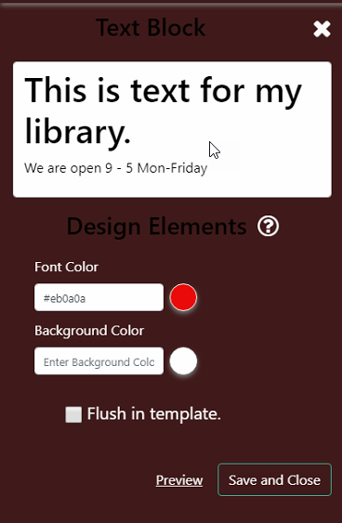
Adding/Editing Pages
Component Type (7 of 9): Text Block
Component | Version 6 | Version 5
Text Block | A text block component is a simple component that displays text data. Staff can set background and foreground colors, and use HTML font, sizing, centering, hyperlinks and other capabilities. Libraries might use this to display their hours or policies in a text presentation. | Was included in the Content Widget’s function, but with far fewer options.

Slide 23
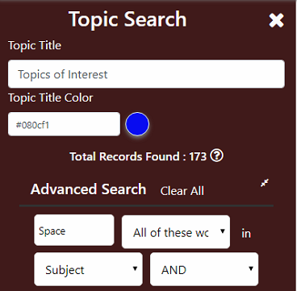
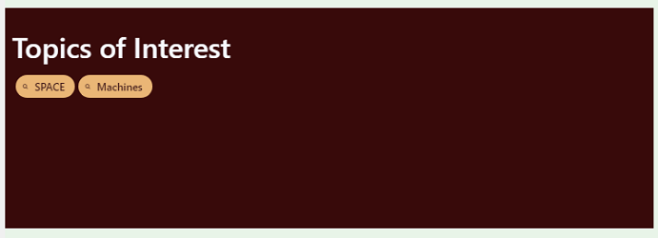
Adding/Editing Pages
Component Type (8 of 9): Topic Search
Component | Version 6 | Version 5
Topic Search | The Topic Search component enables staff to create and configure pre-defined searches (topic searches) by building canned search strategies and displaying them as links (chips) in a component. Topics are defined using the Advanced Search interface. Version 6 topic searches are in ‘chips’ that are horizontally distributed across the width of the component (which, as mentioned above, can vary in size). | Same general function, although more difficult to create and edit topics. Version 5 topic searches were required to be vertical.

Slide 24
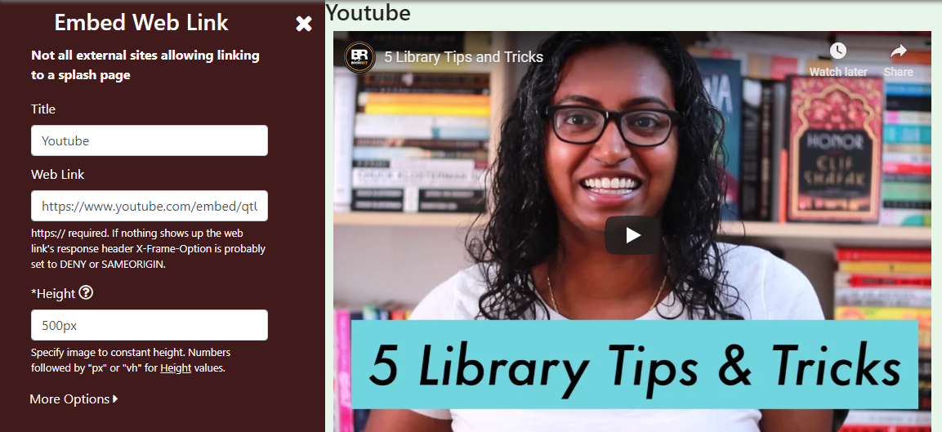
Adding/Editing Pages
Component Type (9 of 9): Embedded Web Links
Component | Version 6 | Version 5
Embedded Web Links | An embedded web link component is one where click the component automatically takes the user to a remote URL. Note that not all external sites allow embedded linking. Staff will need to experiment with the sites they wish to link to. (Example: You cannot link directly to a YouTube URL. You need a special ‘embed’ URL from YouTube for this component to work properly) Ex. Change standard Youtube URL: https://www.youtube.com/watch?v=qtUNbNsHR_M Replace "/watch?v=" with "/embed/" https://www.youtube.com/embed/qtUNbNsHR_M | Same

Slide 25
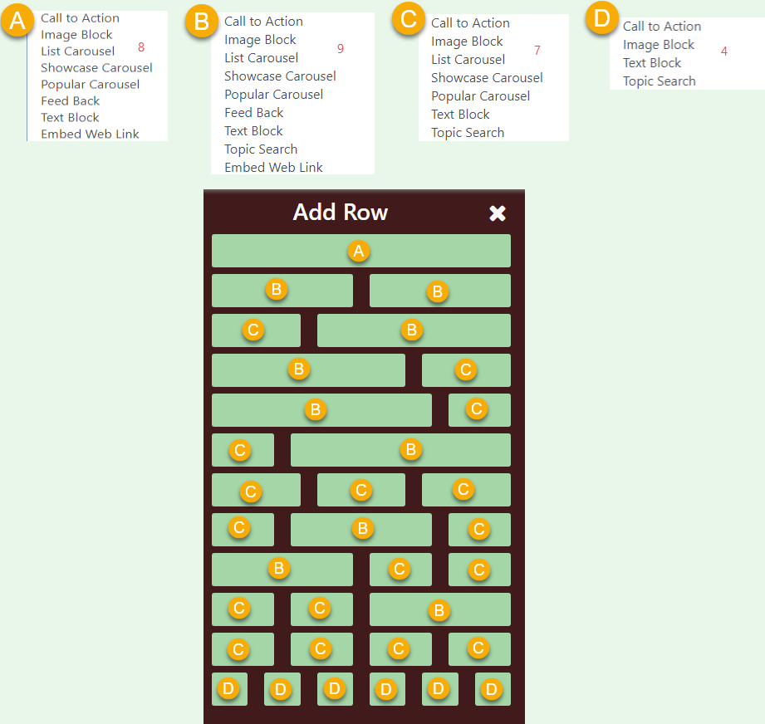
Adding/Editing Pages
Component Listing Reference
When selecting a component row to add to your page, please note each size component will have a variety of the 9 available component types.
Call to Action
Image Block
Popular Carousel
List Carousel
Showcase Carousel
Feedback
Text Block
Topic Search
Embedded Web Links

Slide 26
Contact Us:
If you have any questions, comments, feedback we encourage you to contact us. There are two way to reach us:
This email address is monitored by our Product Managers:
v6comments@auto-graphics.com
You can also reach the Customer Service Managers by emailing:
Auto-Graphics Helpdesk
helpdesk@auto-graphics.com

